Slide 1
Road Accidents in Canada Explored (Project RACE)
Department of
Computer Science
July 10, 2020

Slide 2
TEAM MEMBERS AND TASK
Team Member | Task
Tolu Fatoki | Data Analysis and Exploration with python, Build machine learning model, Testing Project Documentation
Syed Tasrif Ahmed | Web development, Build interactive visuals with chart.js, Build Machine learning model, Testing ,Documentation

Slide 3




A critical message

Slide 4
Project RACE
We have carefully titled this research project RACE to emphasize the fact that driving is not a race against time or competition with other drivers or a Hollywood movie scene but a serious deal that requires close attention at all times and following and obeying the different instructions that have been marked out on our roads and that involves actual people’s life.

Slide 5
Introduction
The importance of road transport to any country and its economy and keeping the roads safe is a top priority for any government
The government Canada has an initiative to achieve road safety with its Road Safety Strategy 2025
Our aim is to help the government in achieving this goal with the help of machine learning

Slide 6

HUMBODLT CRASH 2018

Slide 7
Problem Statement
As there are numerous causes of road accidents we will focus on road configuration and its effect on road accidents
We will explore how having a good understanding of collision hotspots around the country and what measures can be put in place to reduce collision in those types of roads.

Slide 8
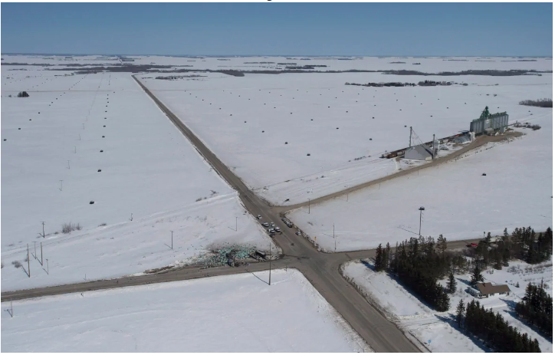
Road Configuration

Slide 9
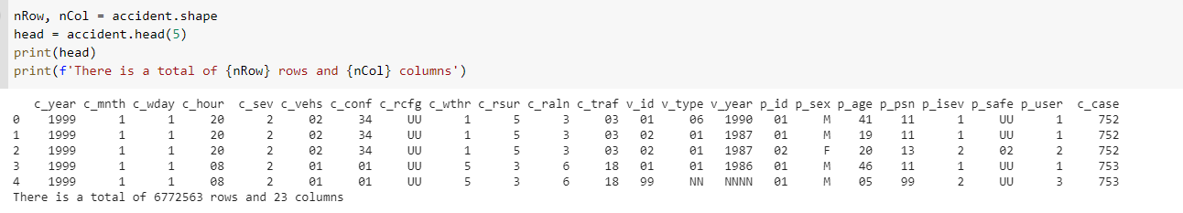
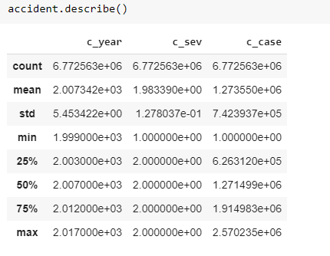
The dataset
The dataset contains information
about road accidents from 1999-2017
Sourced from here
Stored in CSV

Slide 10






Tools

Slide 11
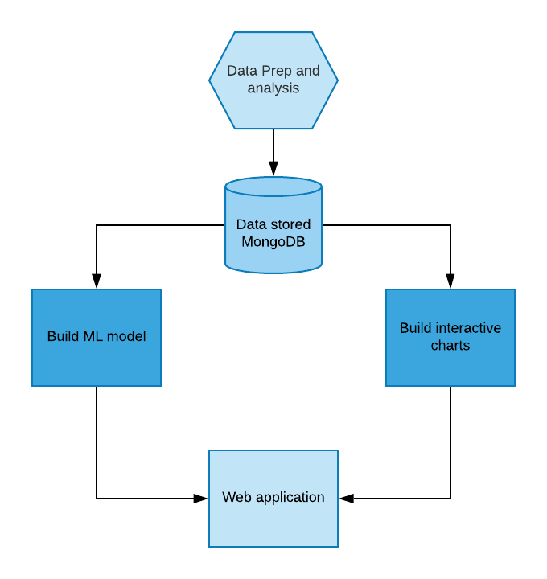
Solution Overview

Slide 12
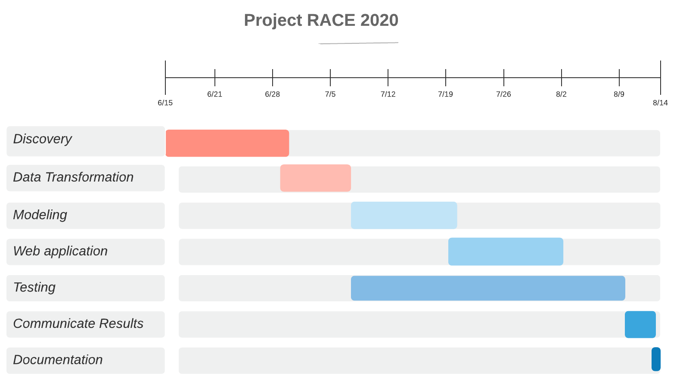
Timeline

Slide 13
Expected outcomes
Our work aims to ensure that the identified problem of continued road accidents on Canadian roads will be reduced significantly by the different findings that we discover in this project
We hope that our research can be adopted and prompt the concerned government agencies to enact laws that will help keep our roads safe especially at different road configurations that require different attention

Slide 14
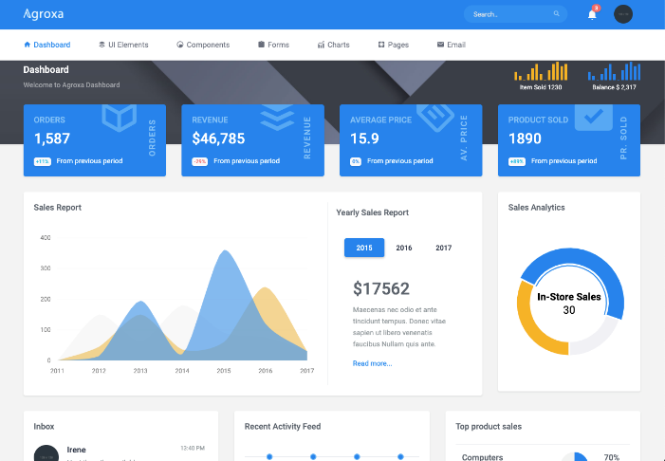
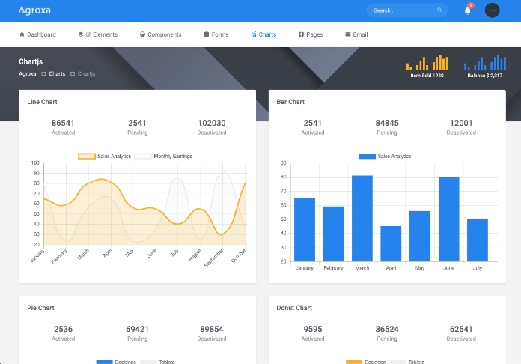
Expected Outcomes

Slide 15
Stretch Goal
We are looking to share our findings and outcomes with Transport Canada and see how they can implement some of our findings and maybe grant us opportunities to further develop our model to consider other factors.

Slide 16
Expected Users/Stakeholders
Transport Canada
Canadian Council of Motor Transport Administration (CCMTA)
Provincial governments
Citizens who require information on road accidents

Slide 17
Conclusion
We believe that the results from the exploratory analysis and machine learning model will be the very first of its kind and it will prompt the concerned authorities to take a closer look at these collision hotspots and help them formulate policies that will assist road users.

Slide 18
THANK YOU!!!!

